Slide 1
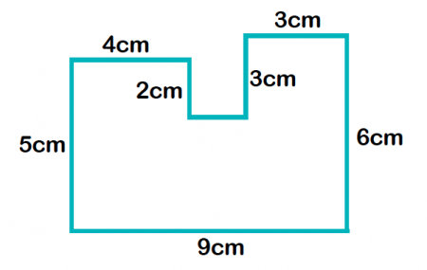
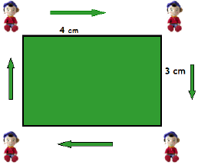
My Measurement
Interactive Notebook
Name
Class: 8-
Teacher: Mr Evans
Term 1 Semester 1

Slide 2
Tasks
24
7
30
Essential Question
Questions
Notes
Summary
6

Slide 3
24
7
30
Date
Topic: Area of a Trapezium
EQ – How do I find the area of a trapezium?
What is a trapezium?
A trapezium is a quadrilateral that has only one pair of parallel sides.

Slide 4
24
7
30
Date
Topic: Area of a Trapezium
EQ – How do I find the area of a trapezium?
How do we find the area of a trapezium?

Slide 5
Area of a Trapezium
a
h
b

Slide 6
Now, piece together the triangular ends so that the trapezium is divided into a triangle and rectangle.
To calculate the area of a trapezium, divide it into a rectangle and two triangles as shown below
b
h
h
a
a - b

Slide 7
Formula
Area of Trapezium = Area of Triangle + Area of Rectangle
= ½ x base x height + base x height
= ½(a-b)h + bh
= h[½(a-b) + b]
= h[ ]
= h[ ]
= h[ ]
a – b 2b
2 2
h
+
a - b
a – b + 2b
2
b
a + b
2
h

Slide 8
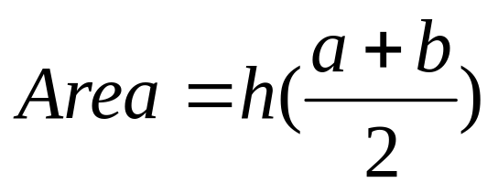
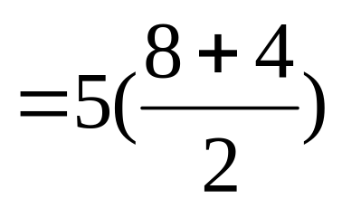
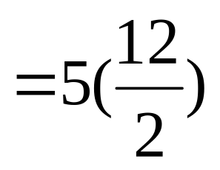
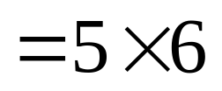
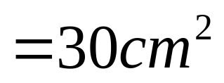
Example
I do.
8 cm
5 cm
4 cm

Slide 9
Wo do.

Slide 10
Your Turn.

